Slide 1
Inference in Linear Regression Uncertainty in estimating the linear regression coefficients

Slide 2
Summary so far
Previously on CS109A
Statistical model
k-nearest neighbors (kNN)
Model fitness and model comparison (MSE)
Goodness of fit (R2)
Linear Regression, multi-linear regression and polynomial regression
Model selection using validation and cross validation
One-hot encoding for categorical variables
What is overfitting

Slide 3
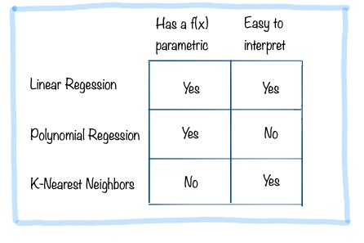




Comparison of Models
We have seen already 3 models. Choosing the right model isn’t’ about minimizing the test error. We also want to understand and get insights from our models.
Having an explicit functional form of f(x) makes it easy to store.
Interpretation is important to evaluate the model and understand what the data tells us

Slide 4
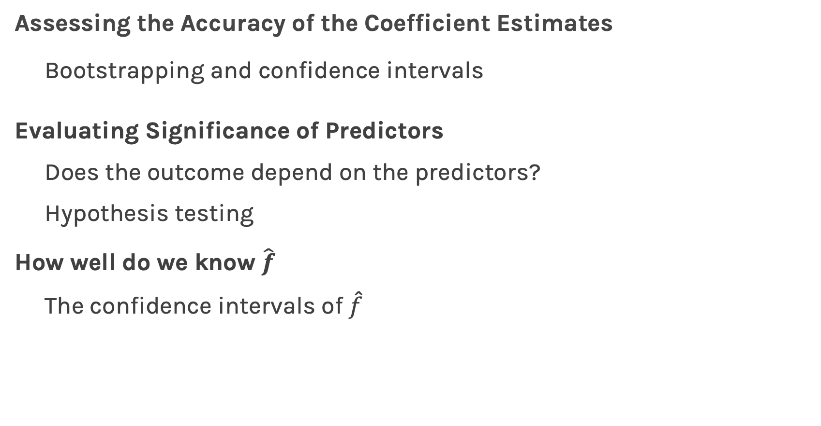
Outline
Assessing the Accuracy of the Coefficient Estimates
Bootstrapping and confidence intervals
Evaluating Significance of Predictors
Does the outcome depend on the predictors?
Hypothesis testing
How well do we know $\hat{f}$
The confidence intervals of $\hat{f}$

Slide 5
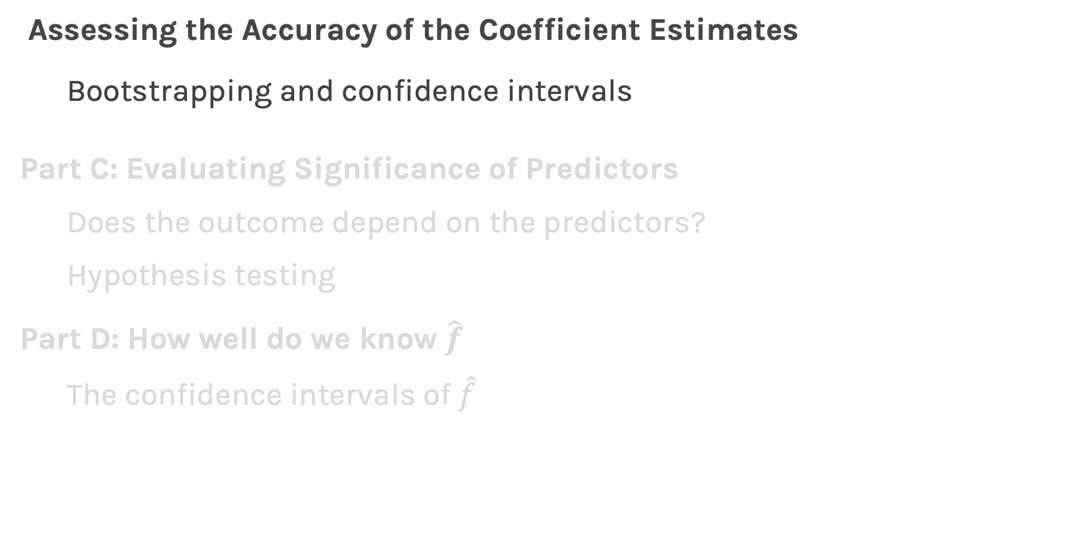
Outline
Assessing the Accuracy of the Coefficient Estimates
Bootstrapping and confidence intervals
Part C: Evaluating Significance of Predictors
Does the outcome depend on the predictors?
Hypothesis testing
Part D: How well do we know $\hat{f}$
The confidence intervals of $\hat{f}$

Slide 6
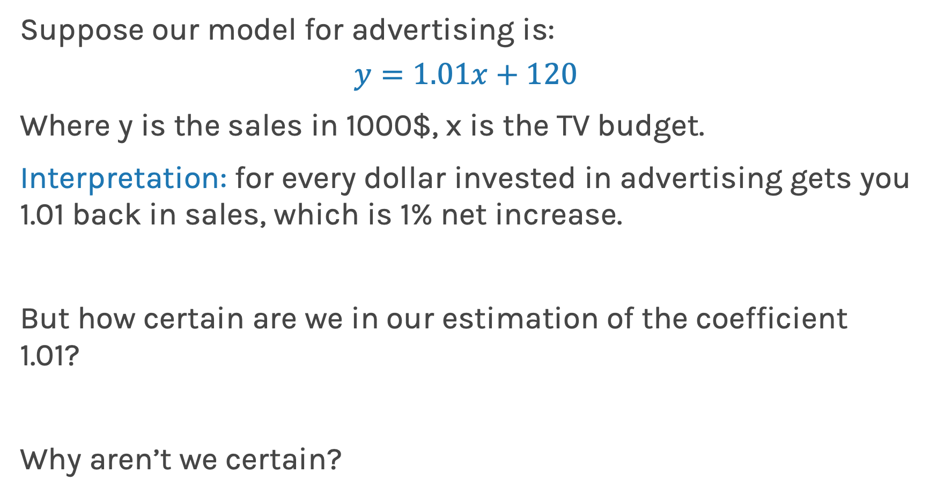
How reliable are the model interpretation
Suppose our model for advertising is:
$$y=1.01x+120$$
Where y is the sales in 1000$, x is the TV budget.
Interpretation: for every dollar invested in advertising gets you 1.01 back in sales, which is 1% net increase.
But how certain are we in our estimation of the coefficient 1.01?
Why aren’t we certain?

Slide 7
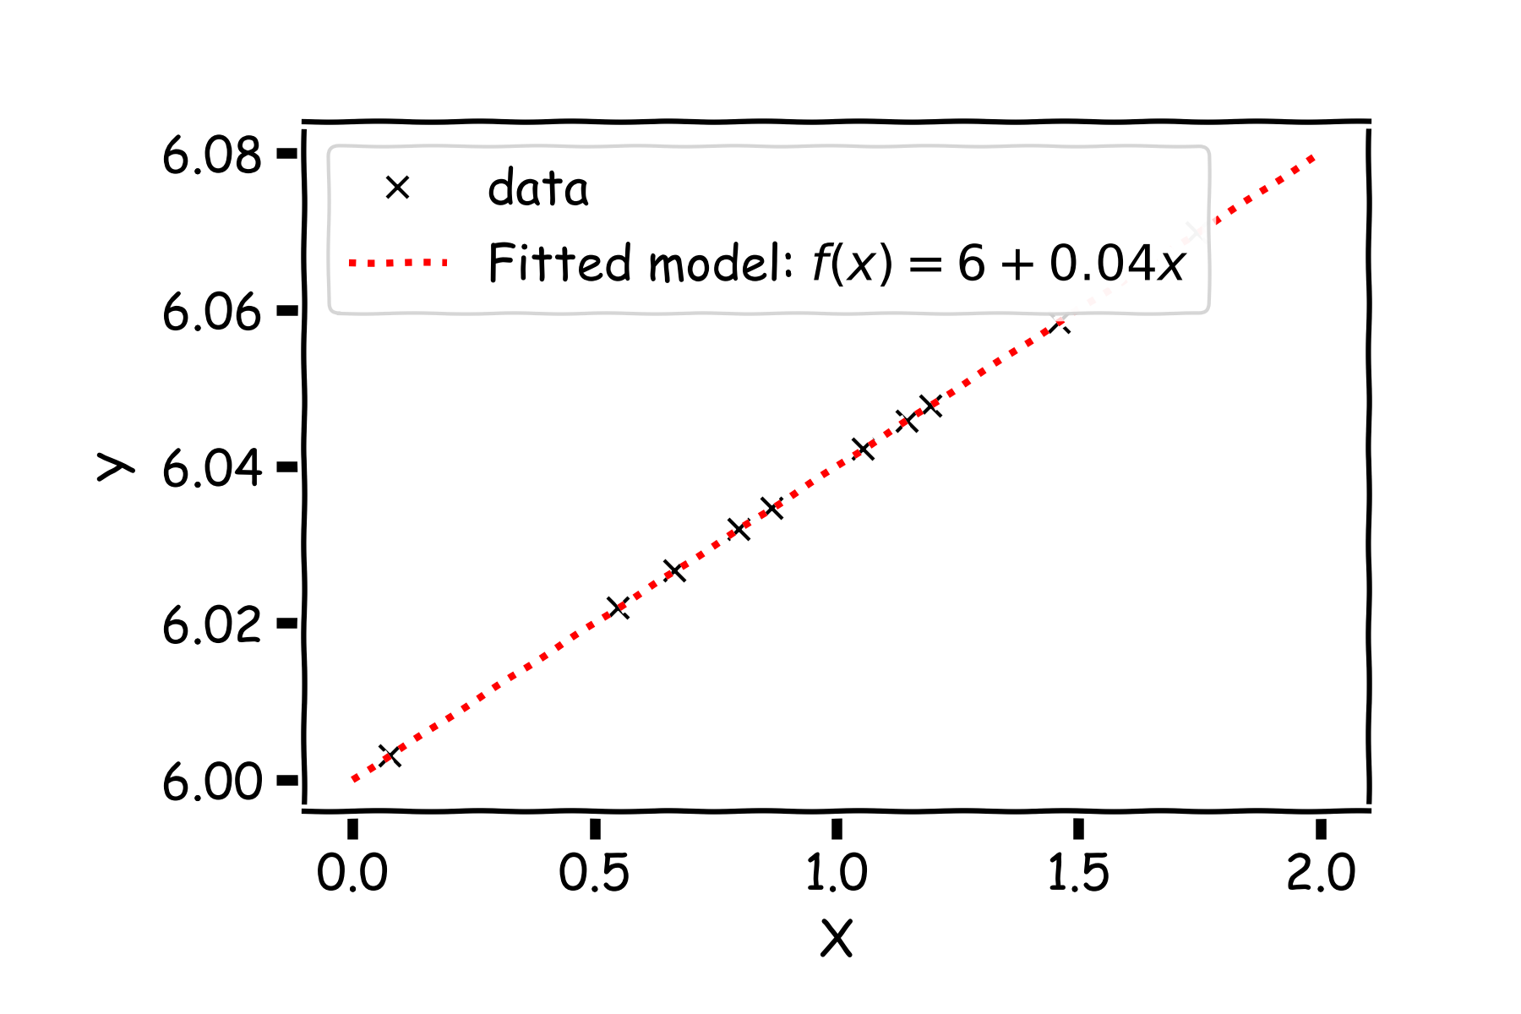
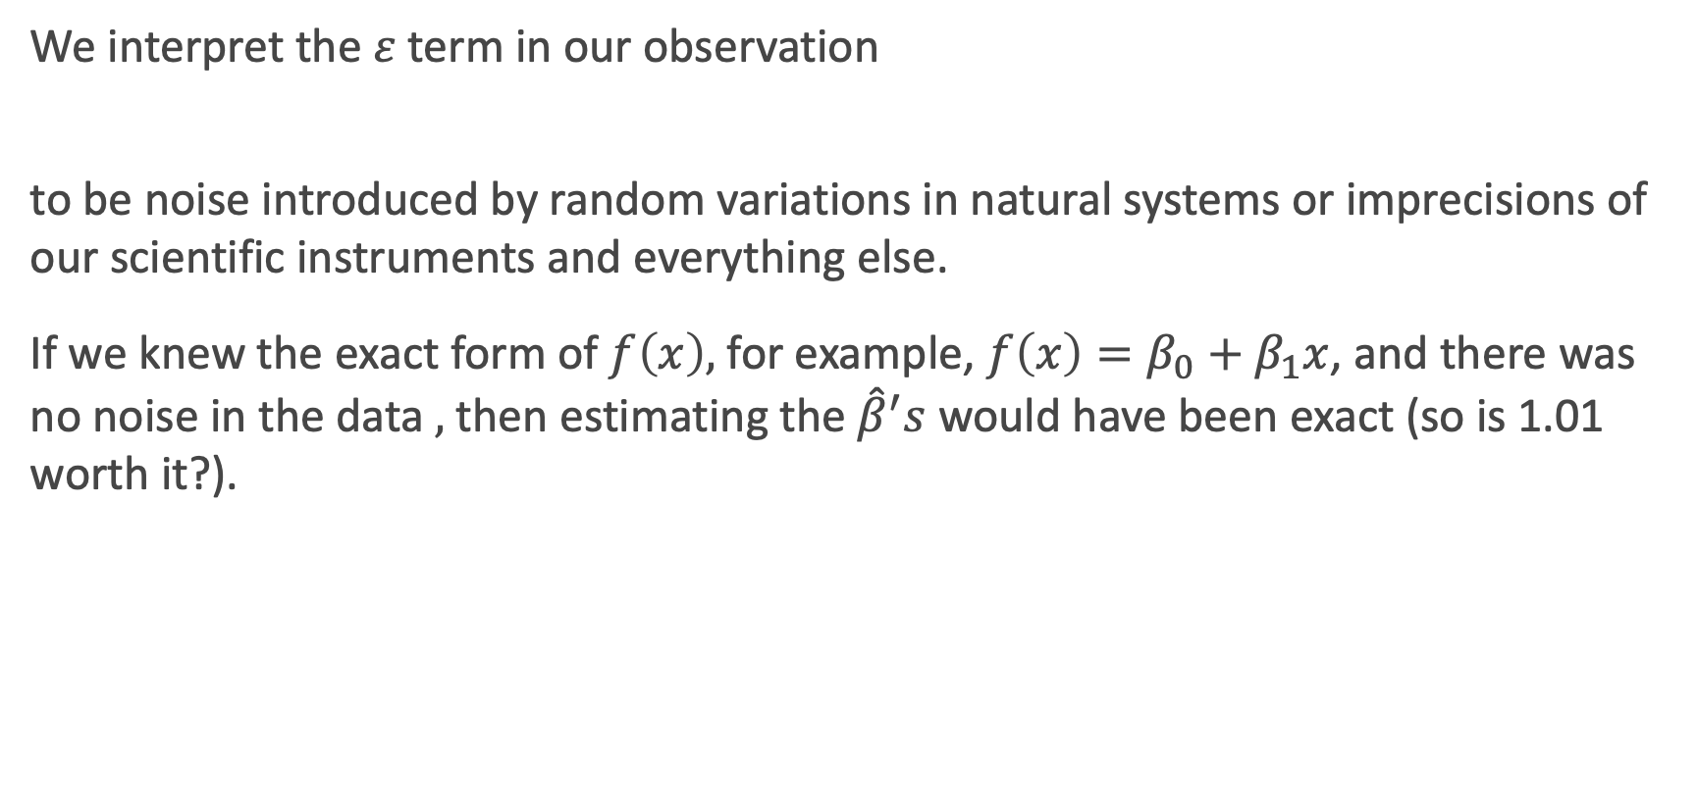
Confidence intervals for the predictors estimates
We interpret the $ε$term in our observation
to be noise introduced by random variations in natural systems or imprecisions of our scientific instruments and everything else.
If we knew the exact form of $f\left(x\right),$for example, $f\left(x\right)=β_{0}+β_{1}x$, and there was no noise in the data$,$ then estimating the ${\hat{β}}^{′}s$ would have been exact (so is 1.01 worth it?).
Notes:
Axes labels! (DLS)

Slide 8
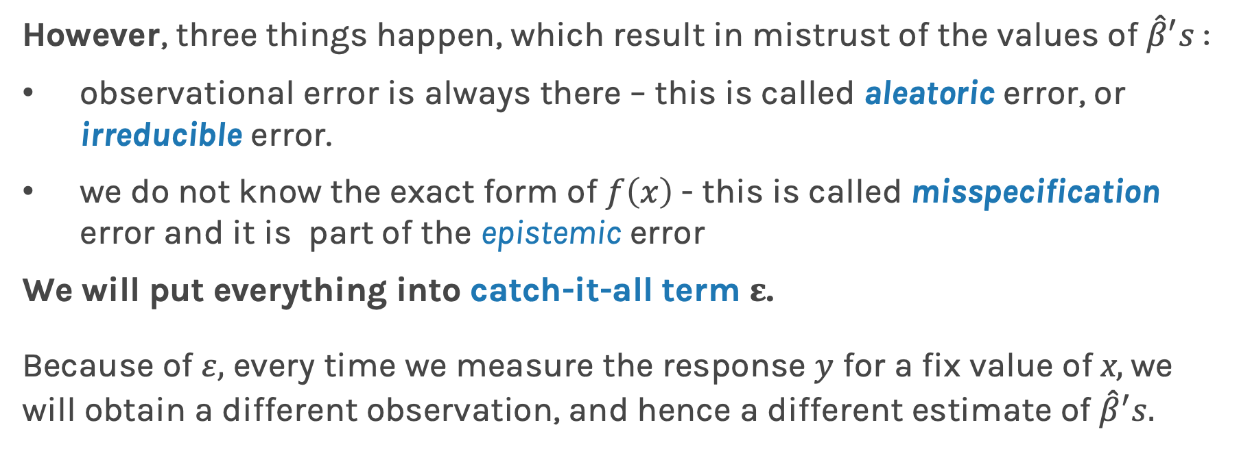
Confidence intervals for the predictors estimates (cont)
However, three things happen, which result in mistrust of the values of ${\hat{β}}^{′}s$:
observational error is always there – this is called aleatoric error, or irreducible error.
we do not know the exact form of $f\left(x\right)$ - this is called misspecification error and it is part of the epistemic error
We will put everything into catch-it-all term $ε$.
Because of $ε,$ every time we measure the response $y$ for a fix value of x$,$we will obtain a different observation, and hence a different estimate of ${\hat{β}}^{′}s.$

Slide 9
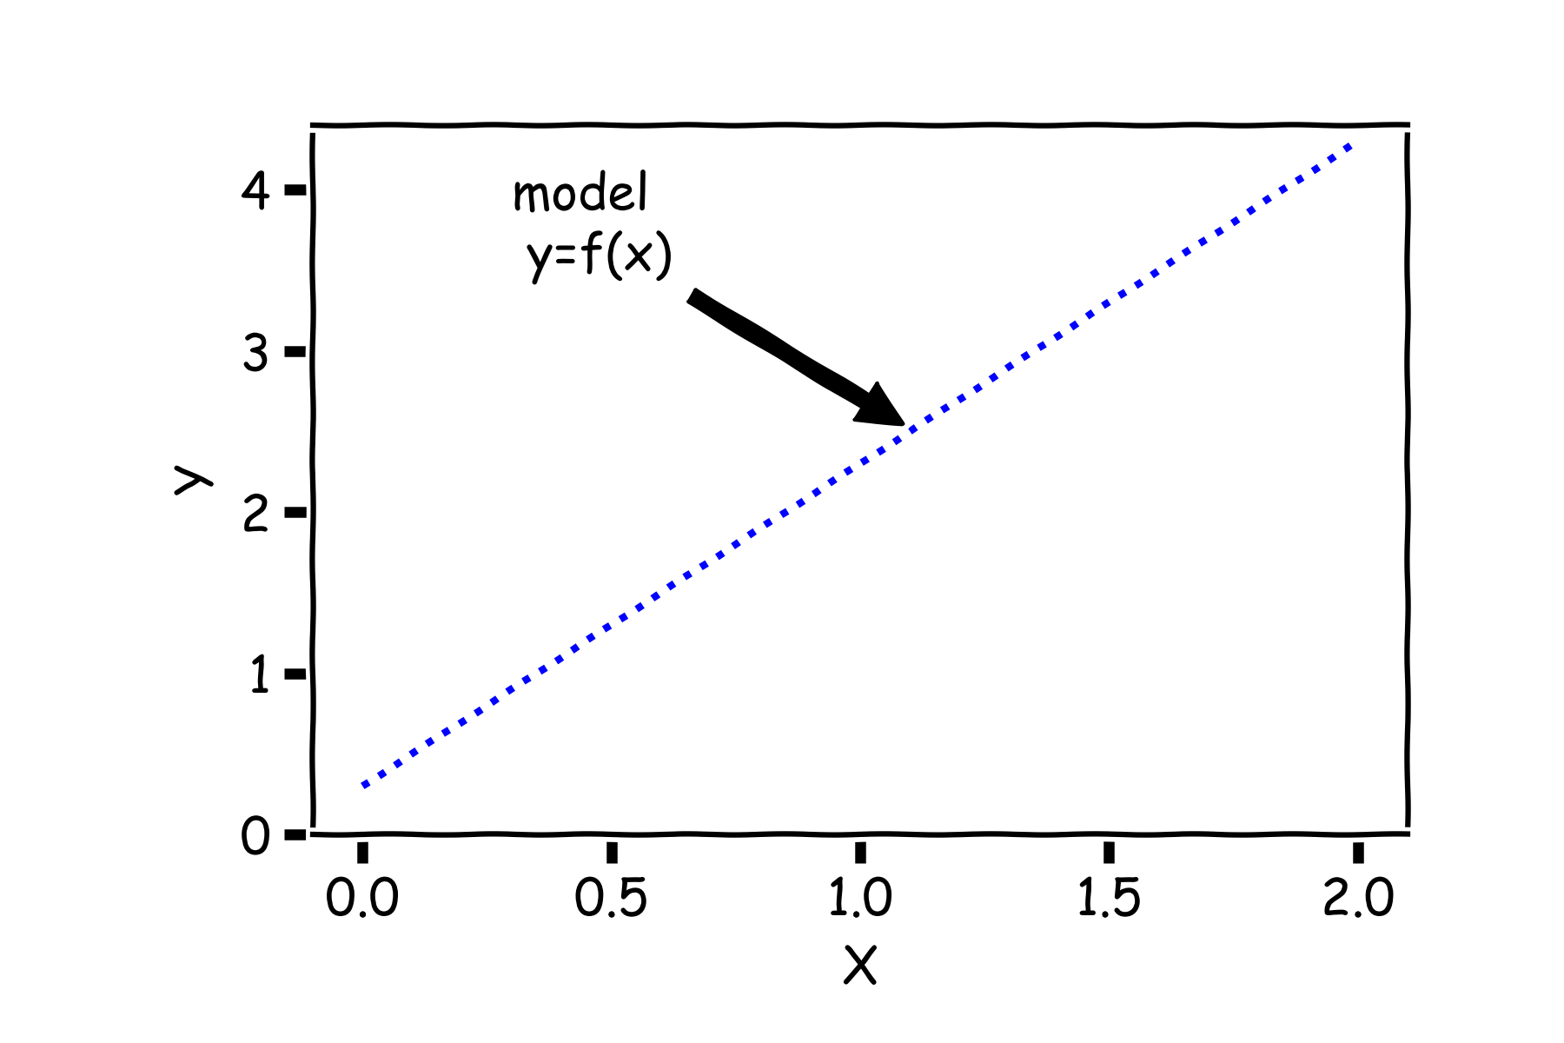

Confidence intervals for the predictors estimates (cont)
Start with a model $f\left(X\right),$ the correct relationship between input and outcome.

Slide 10
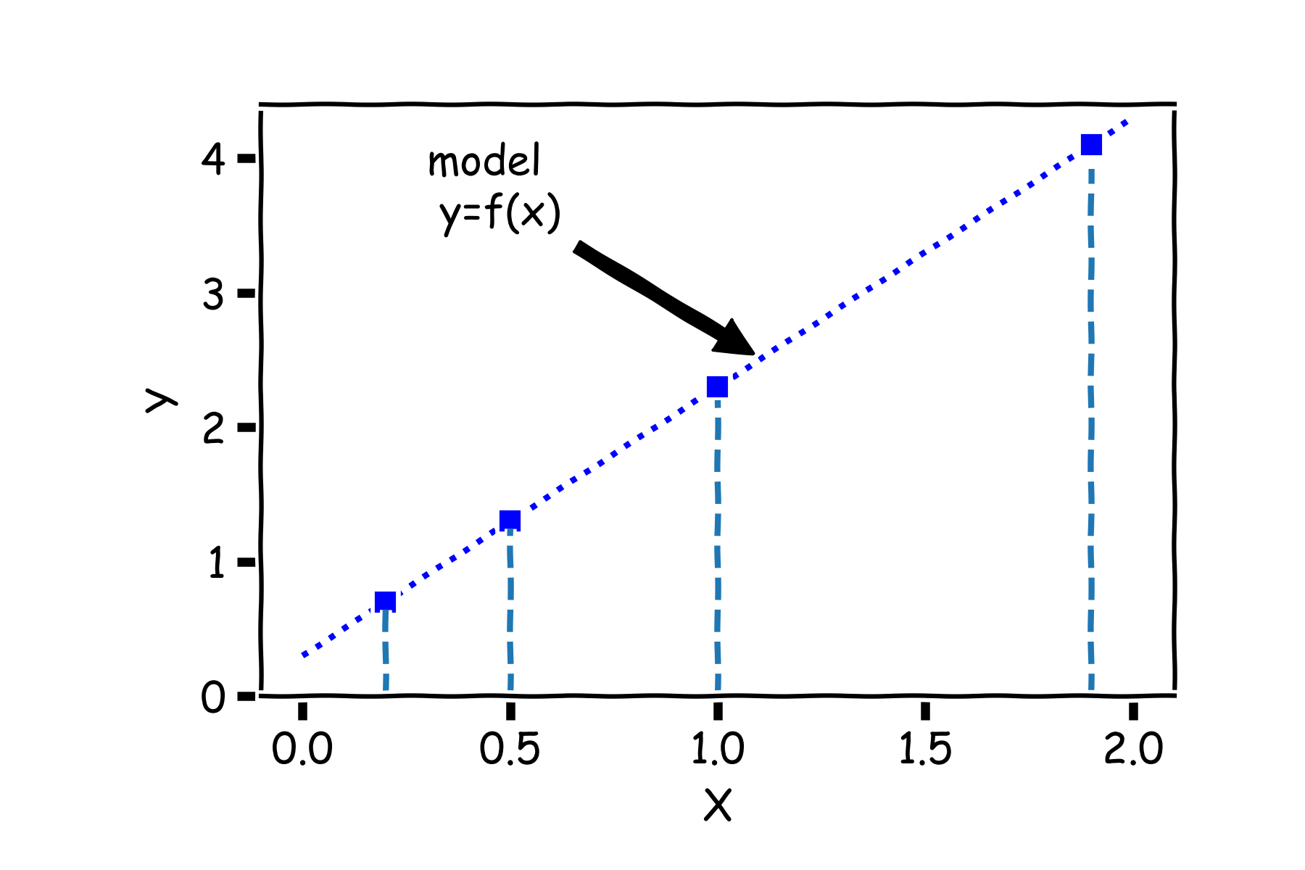

Confidence intervals for the predictors estimates (cont)
For some values of $X^{⋆},$ $Y^{⋆}=f(X^{⋆})$

Slide 11
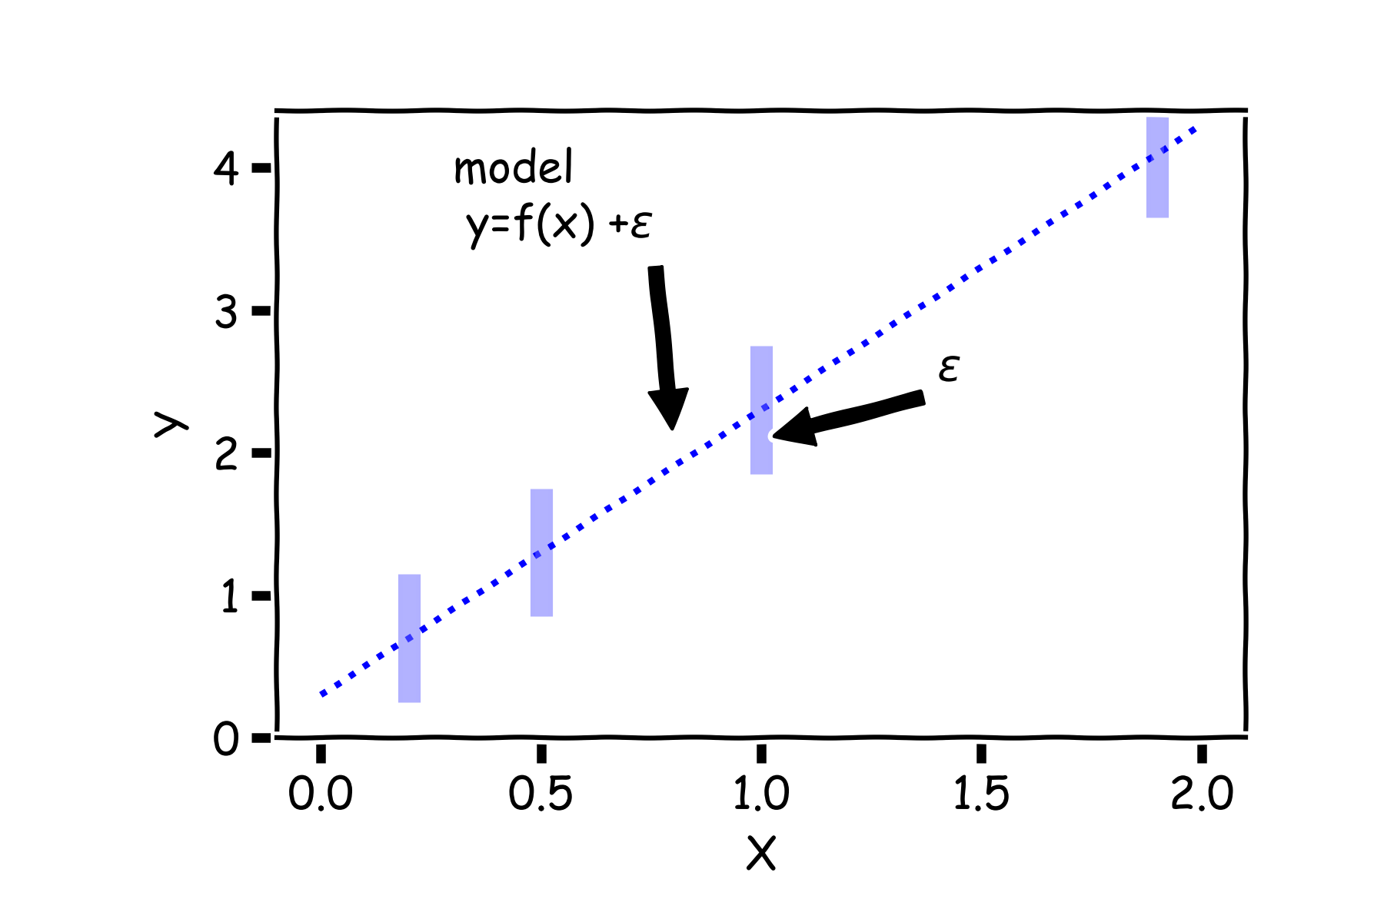

Confidence intervals for the predictors estimates (cont)
But due to error, every time we measure the response Y for a fixed value of $X^{⋆}$ we will obtain a different observation.

Slide 12
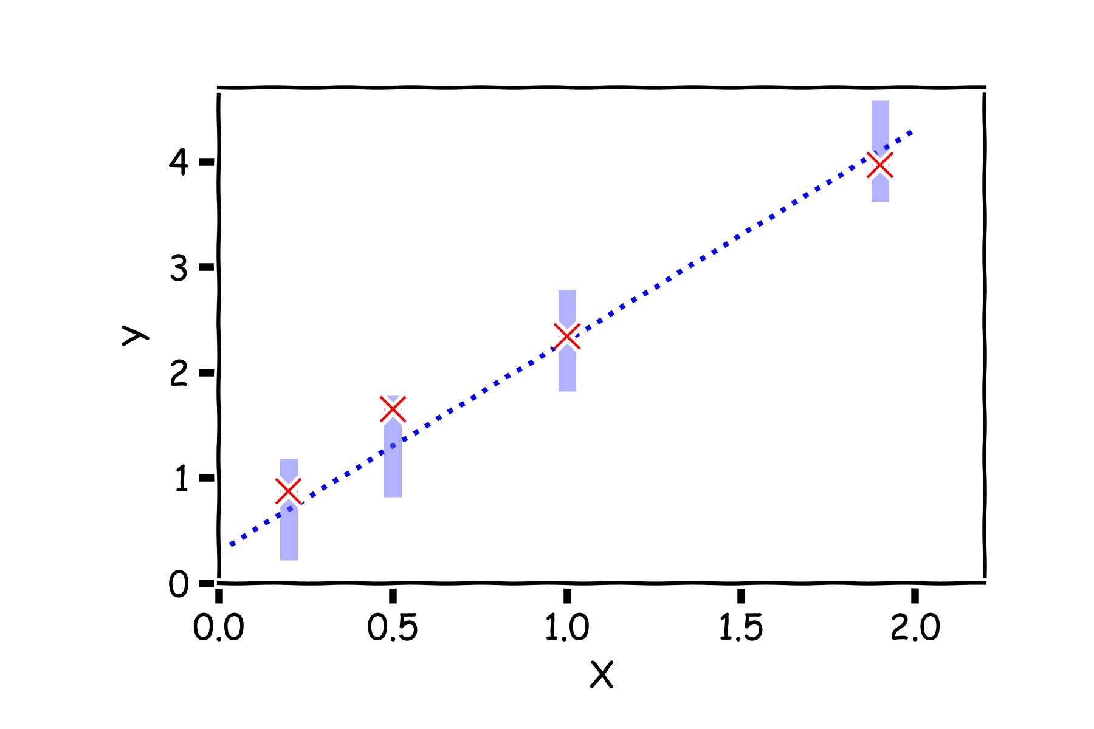
Confidence intervals for the predictors estimates (cont)
One set of observations, “one realization” yields one set of Ys (red crosses).

Slide 13
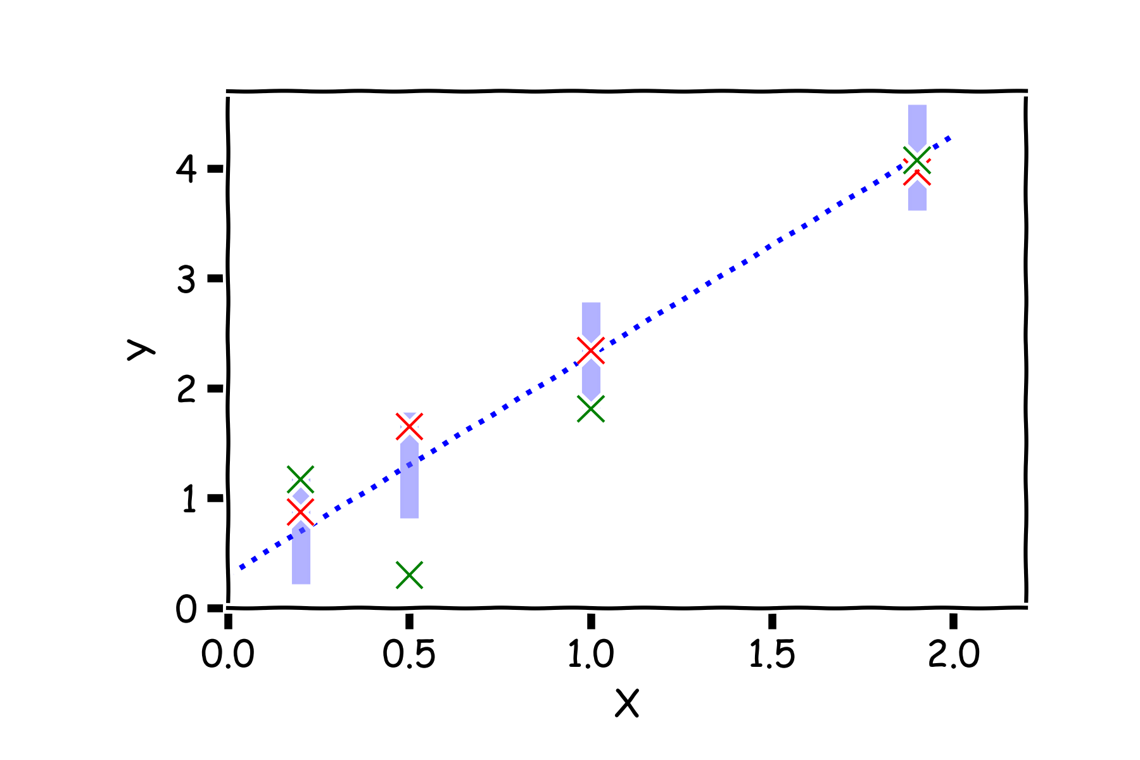
Confidence intervals for the predictors estimates (cont)
Another set of observations, “another realization” yields another set of Ys (green crosses).

Slide 14
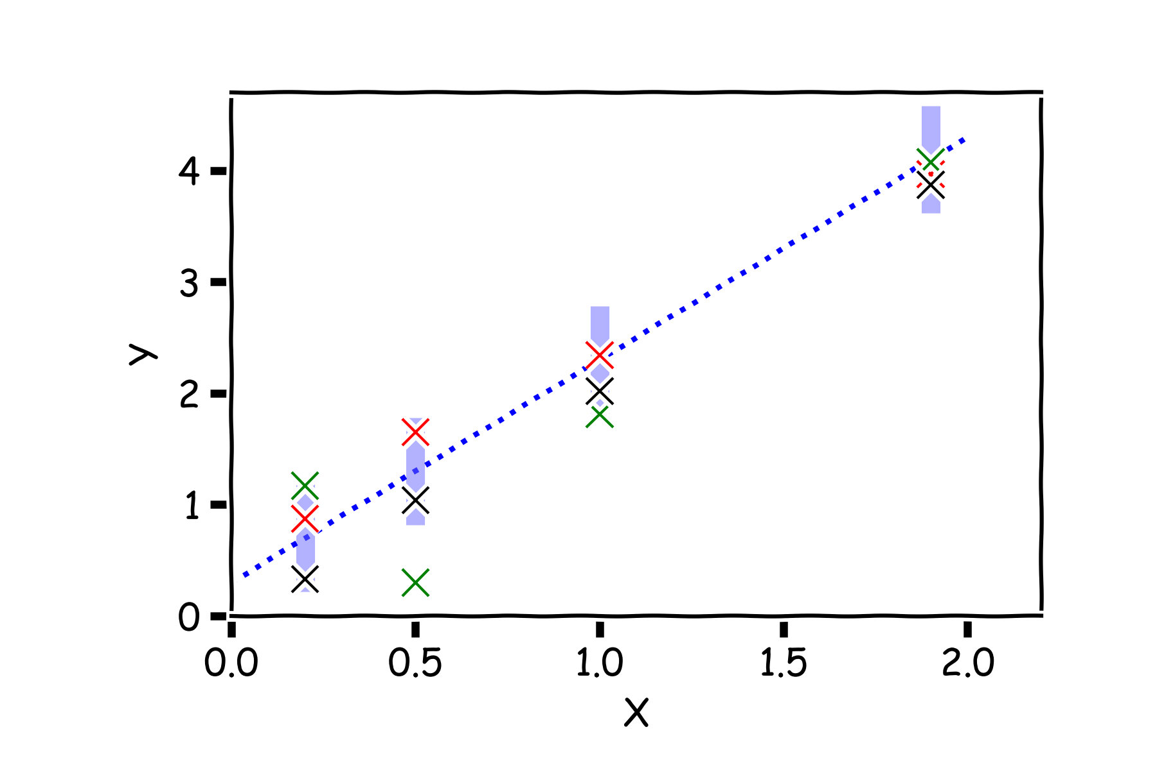
Confidence intervals for the predictors estimates (cont)
Another set of observations, “another realization”, another set of Ys (black crosses).

Slide 15
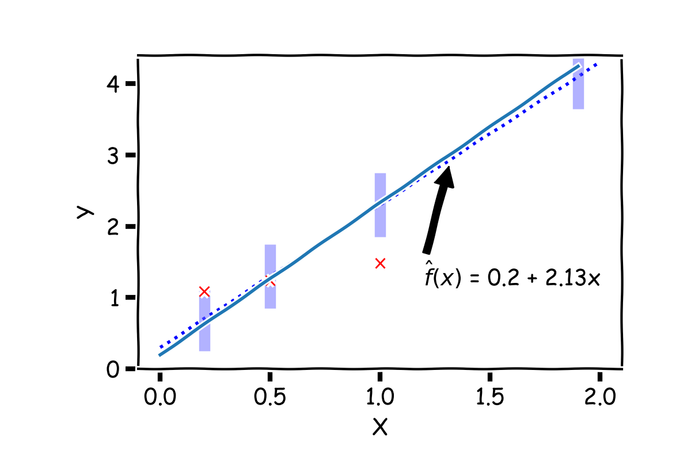

Confidence intervals for the predictors estimates (cont)
For each one of those “realizations”, we fit a model and estimate ${\hat{β}}_{0}$ and ${\hat{β}}_{1}.$

Slide 16
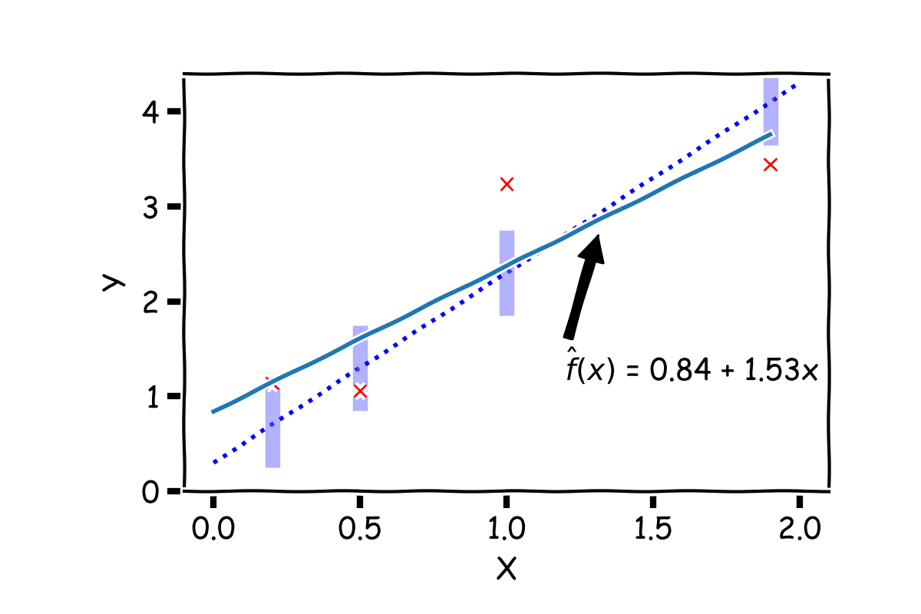

Confidence intervals for the predictors estimates (cont)
For another “realization”, we fit another model and get different values of ${\hat{β}}_{0}$ and ${\hat{β}}_{1}.$

Slide 17
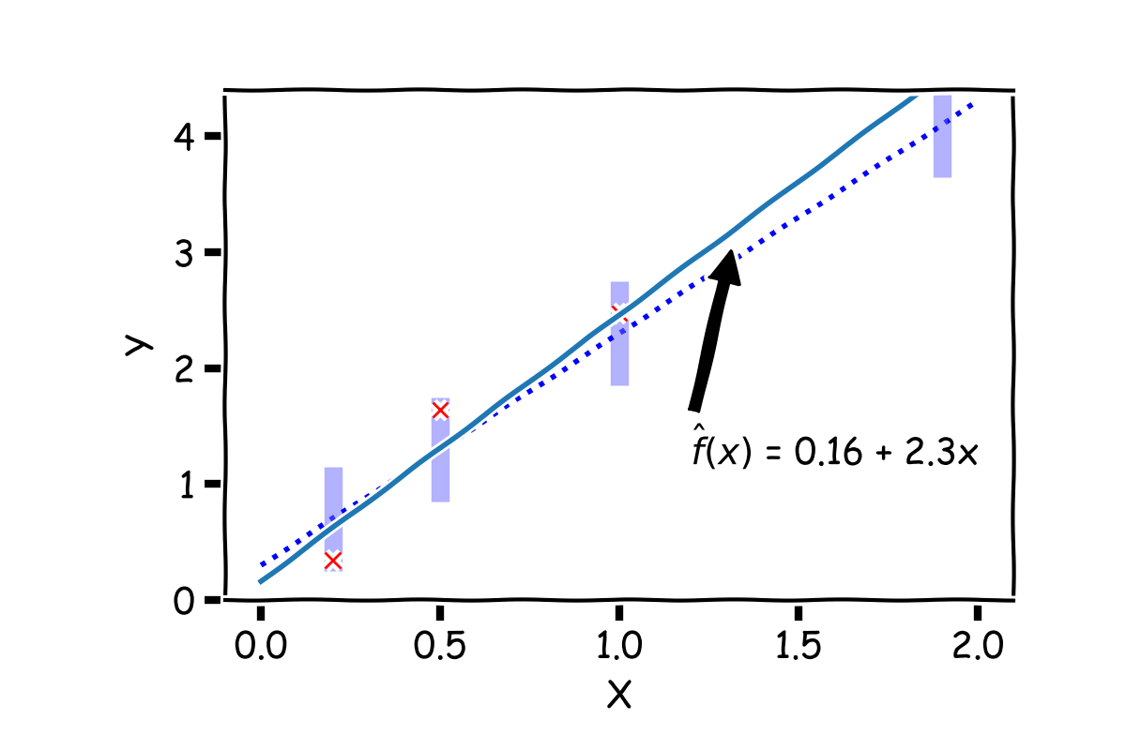

Confidence intervals for the predictors estimates (cont)
For another “realization”, we fit another model and get different values of ${\hat{β}}_{0}$ and ${\hat{β}}_{1}.$

Slide 18
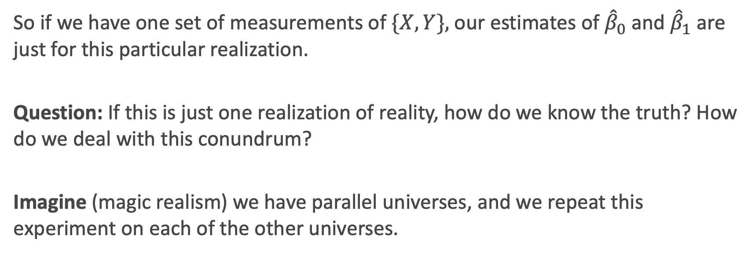
Confidence intervals for the predictors estimates (cont)
So if we have one set of measurements of $\{X,Y\},$our estimates of ${\hat{β}}_{0}$ and ${\hat{β}}_{1}$ are just for this particular realization.
Question: If this is just one realization of reality, how do we know the truth? How do we deal with this conundrum?
Imagine (magic realism) we have parallel universes, and we repeat this experiment on each of the other universes.
Universe A
Universe B
Universe C

Slide 19

Confidence intervals for the predictors estimates (cont)
So if we have one set of measurements of $\{X,Y\},$our estimates of ${\hat{β}}_{0}$ and ${\hat{β}}_{1}$ are just for this particular realization.
Question: If this is just one realization of reality, how do we know the truth? How do we deal with this conundrum?
Imagine (magic realism) we have parallel universes, and we repeat this experiment on each of the other universes.
Universe A
Universe B
Universe C

Slide 20
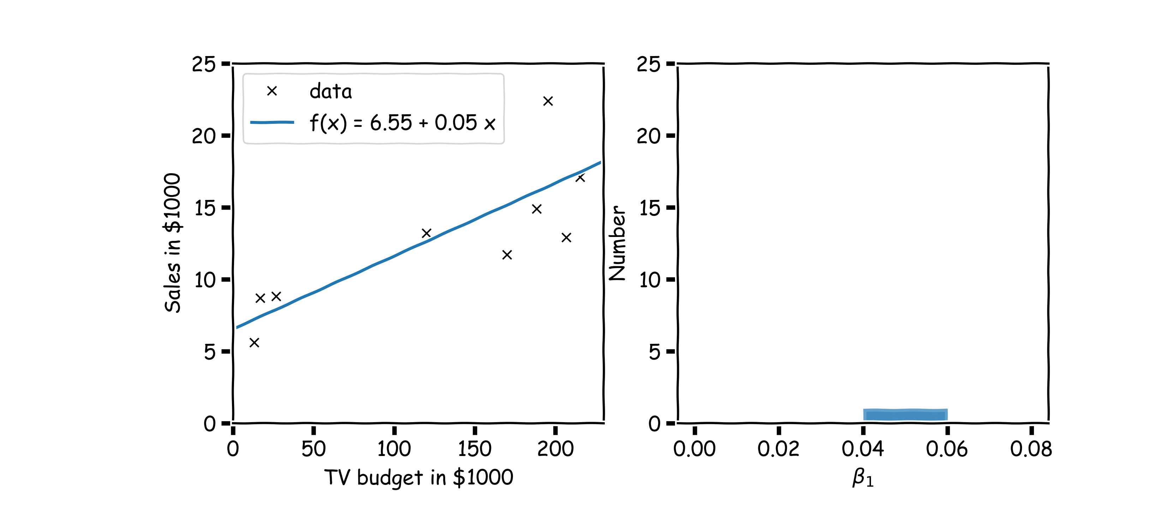



Confidence intervals for the predictors estimates (cont)
$$.$$
In our magical realisms, we can now sample multiple times. One universe, one sample, one set of estimates for ${{\hat{β}}_{0}, \hat{β}}_{1}$
There will be an equivalent plot for ${\hat{β}}_{0}$ which we don’t show here for simplicity

Slide 21
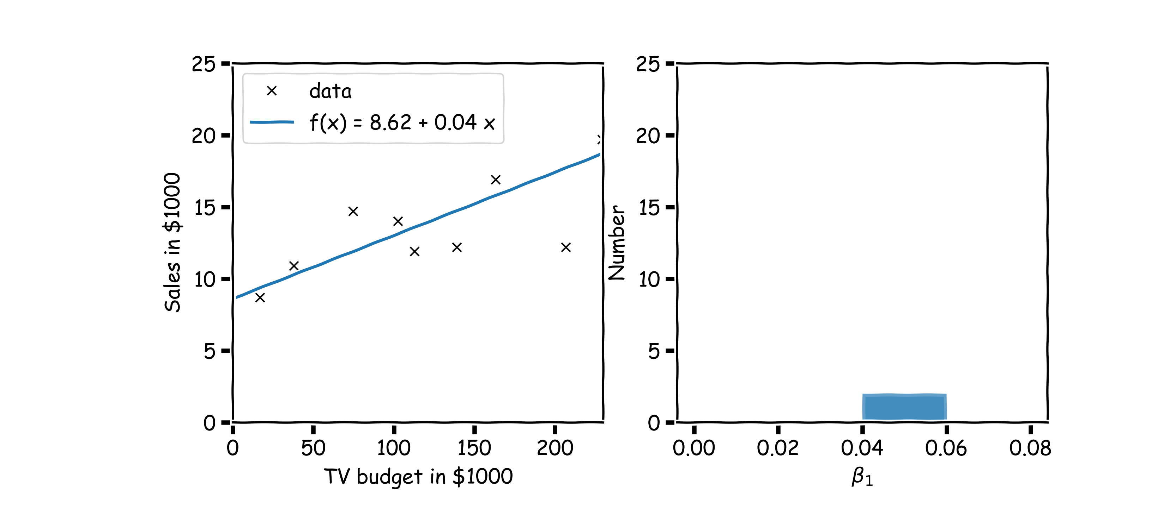

Confidence intervals for the predictors estimates (cont)
Another sample, another estimate of ${{\hat{β}}_{0}, \hat{β}}_{1}$

Slide 22
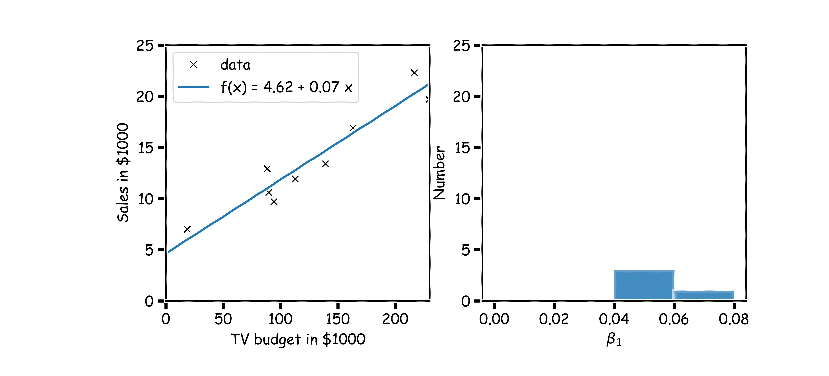
Confidence intervals for the predictors estimates (cont)
Again

Slide 23
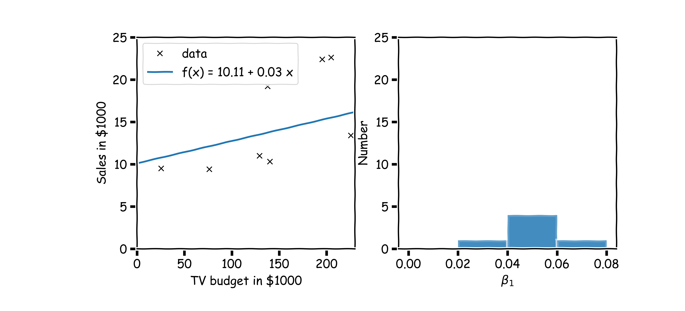
Confidence intervals for the predictors estimates (cont)
And again

Slide 24
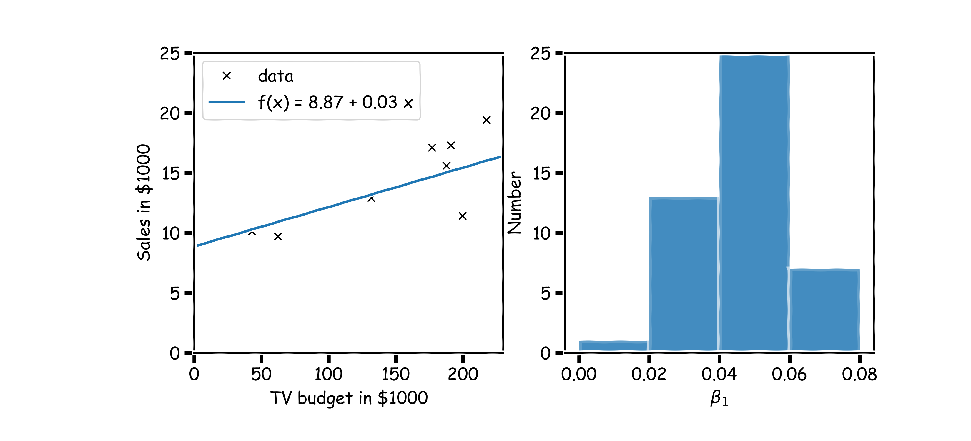

Confidence intervals for the predictors estimates (cont)
Repeat this for 100 times, until we have enough samples of ${{\hat{β}}_{0}, \hat{β}}_{1}.$

